Slide 1

Electric Vehicle Population Analysis
Prepared and Presented by Atanas Vasilev

Slide 2
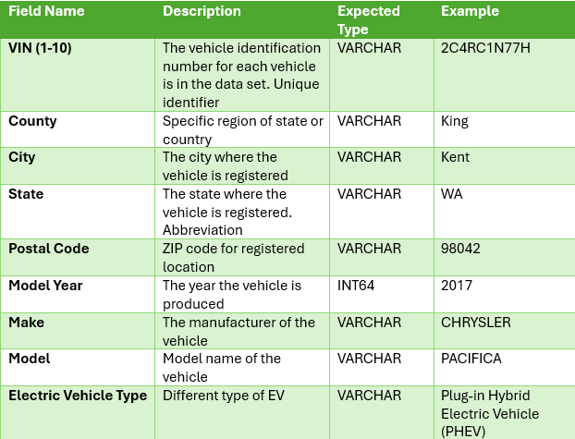
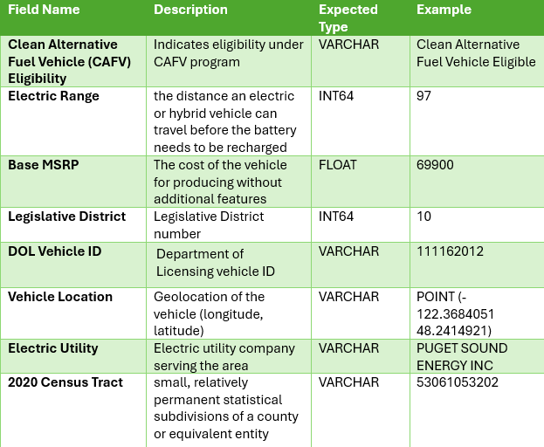
Introduction on Electric Vehicle Population

Slide 3
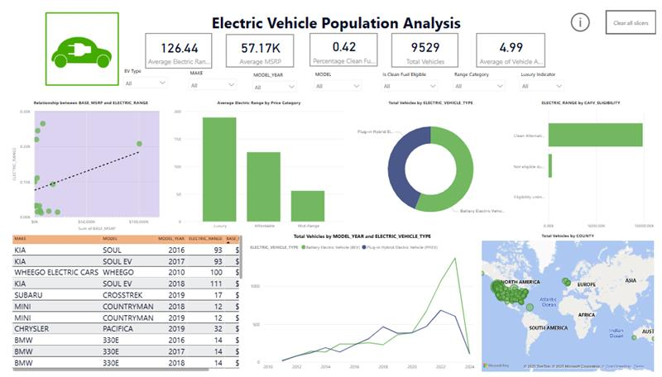
Power BI Visualization

Slide 4
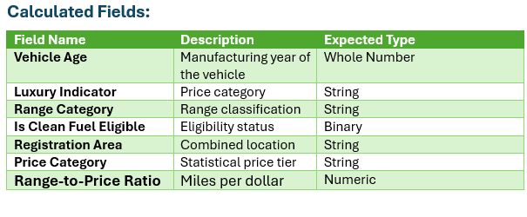
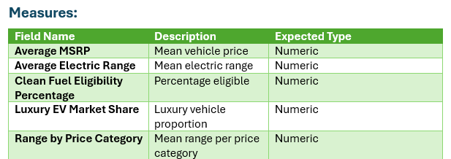
Calculated Fields and Measures in Power BI

Slide 5
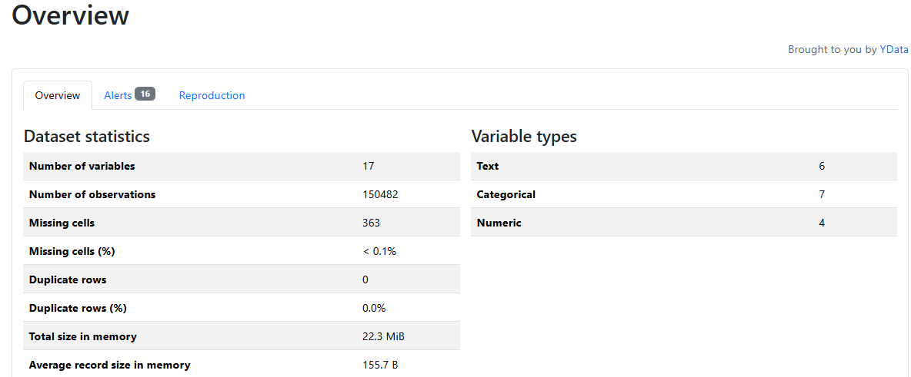
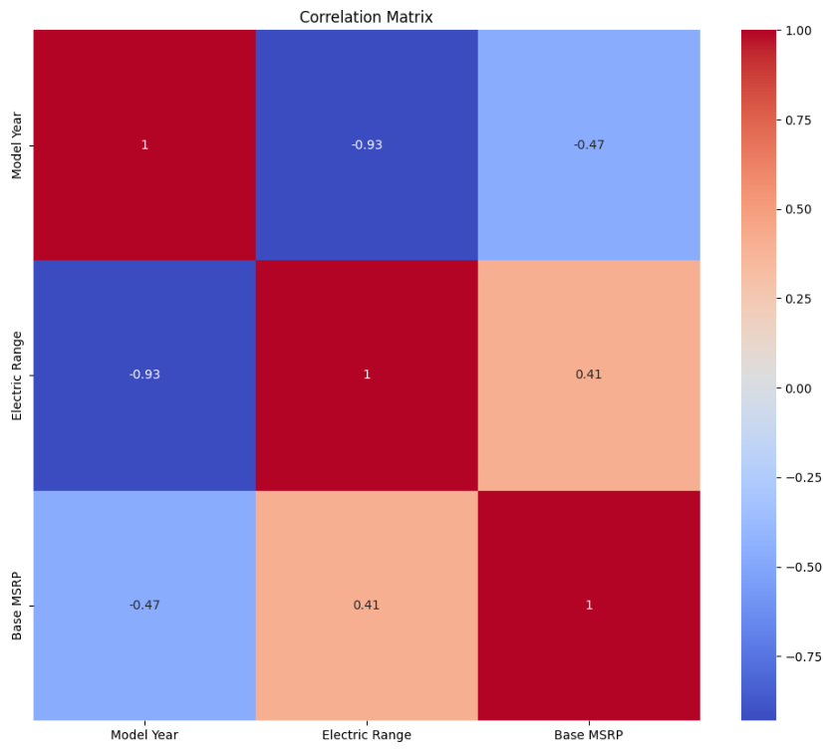
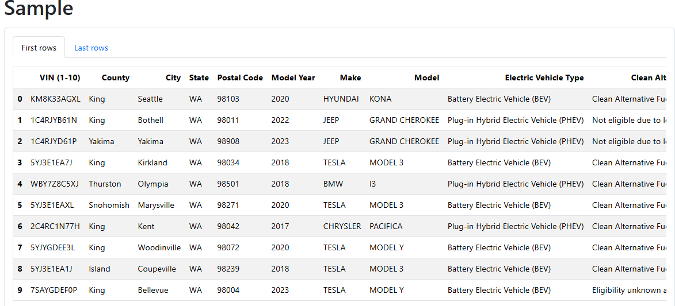
Data Profiling with Python
Notes:
From the correlation matrix we can conclude that Electric Range with Model Yeare have a strong negative correlation coeffiecient. This means the EVs are producing with short to mid-range Electric range with increasing of Model Year. Manufacturers are producing more EVs for city ranges, rather than long intercity ranges. Base MRSP with Model Year have -0.47 Correlation coefficient, which is showing negative moderate corellation, which is telling us the newest produced EVs have a lower base MSRP for production. Base MSRP and Electric Range is showing a positive moderate correlation coefficient with 0.41, which could be interpretated as EVs with longer Electric Range tend to have higher base production prices.

Slide 6
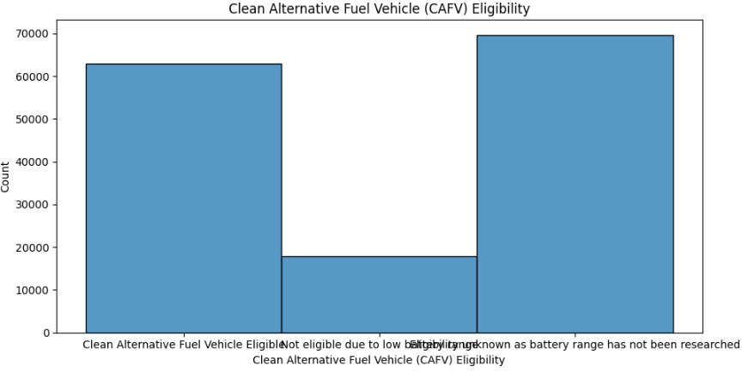
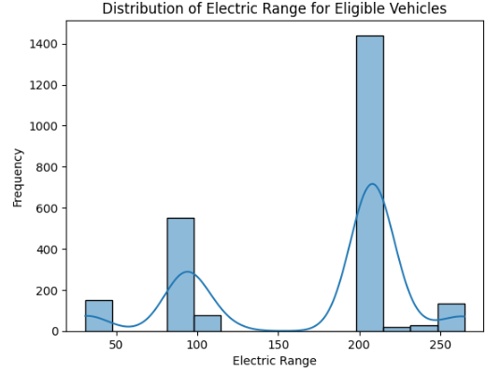
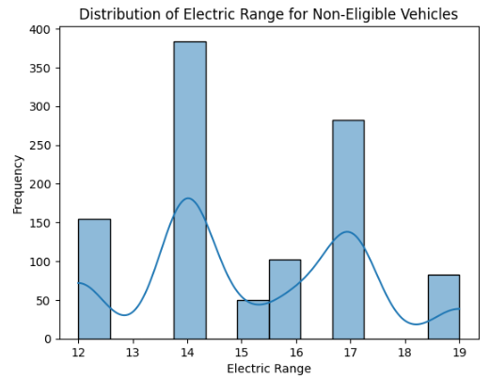
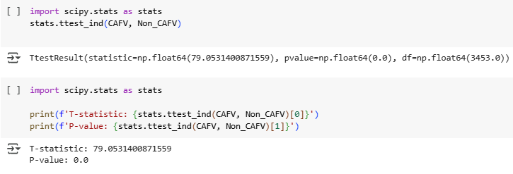
Hypothesis Testing
Do Clean Alternative Fuel Eligible vehicles have significantly higher electric ranges?
Notes:
From our independant hypothesis testing of our two samples, we are receiving a results with T-stats for 79 and p-value for 0.0. Our p-value 0.0 is smaller than our confidence level, so we reject the null hypothesis and accept the alternative hypothesis.
Our alternative hypothesis is - Clean Alternative Fuel Eligible vehicles have a higher mean electric range than Non-Eligible vehicles
T-statistics for 79 means that we have a large difference between our sample means, which could be from the variarity of our data and it supports our performed test and accepting the alternative hypothesis.

Slide 7
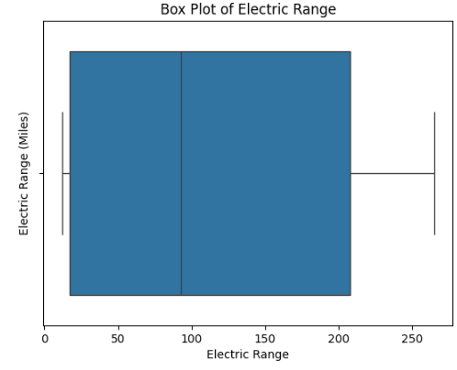
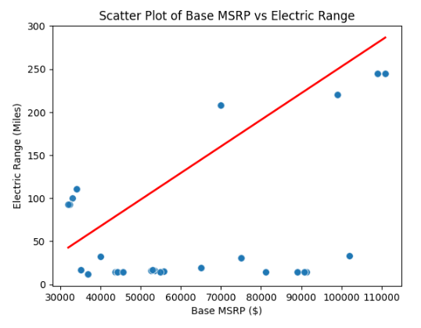
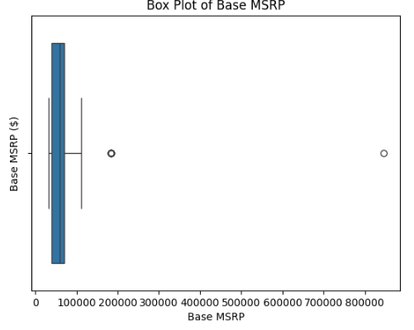
Regression Analysis
Is there a positive relationship between MSRP and Electric Range?
Notes:
From the above Scatter Plot visualization, we see a positive linear regression with positive trend. This could be analysed as the more expensive EVs have a longer ELectric Range. We have some clusters of data and not values around the regression line, which is formed by the fact we have clustered data based on the variety of EVs. Our relationship is positive moderate strongs, as we don't have majority of values around the regression line.

Slide 8
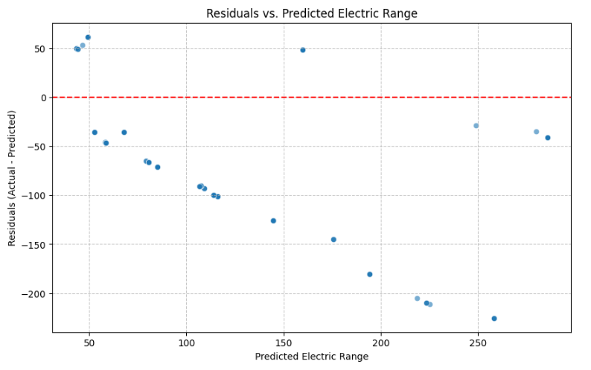


Supervised Machine Learning with Linear Regression
Notes:
The R-squared value of 0.3906 indicates around 39.06% of the variance in Electric Range can be explained by Base MSRP. The rest of approx. 60% could be explained by different factor and relationships. The Root Mean Squared Error (RMSE) of 67.74 means, on average, our predictions are off by about 67.74 miles from the actual electric range.

Slide 9
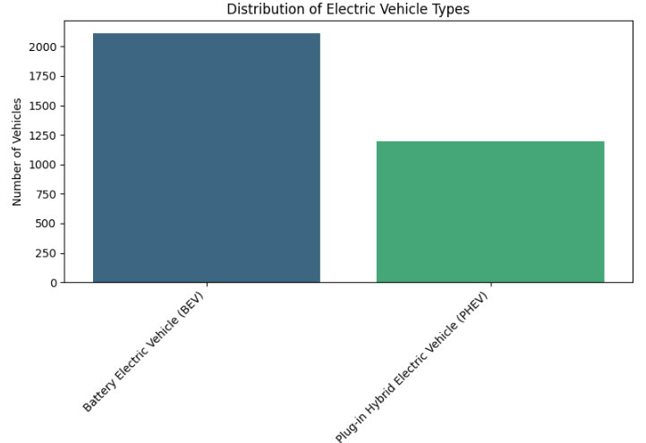
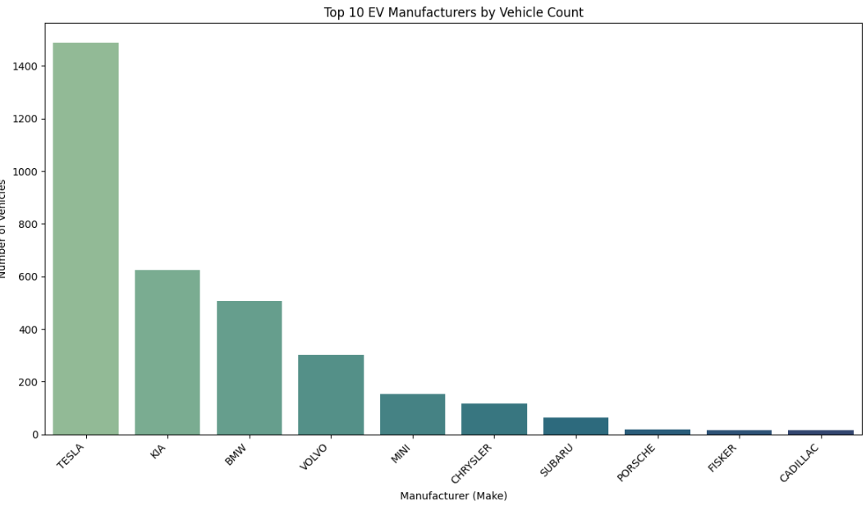
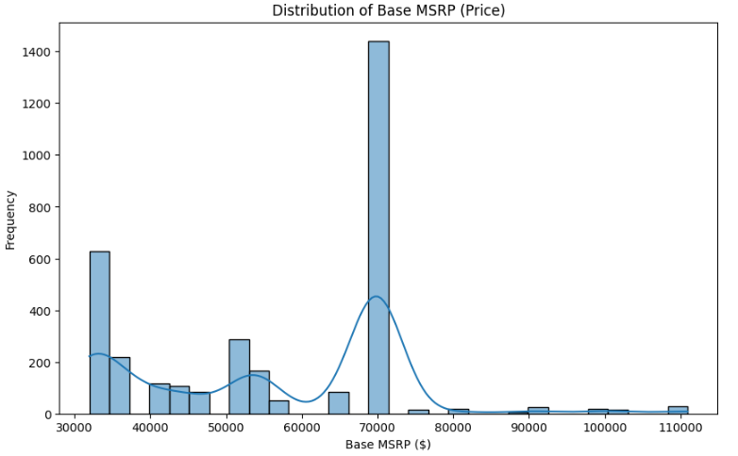
Electric Vehicles Segmentation
How are EVs distributed by type, price, and manufacturer?
Notes:
Business Insights: We can clearly see the prices is a dominant factor for EVs segmantations Also, the Manufacturers with the biggest brand names (TESLA) is dominanting the market for EVs. Also Porshe with his known name for premium cars is also producing a high-level premium EVs car, which we can see it has price over 800KThemajorityofpricesforEVsareintherangeof50K to 120K$, which is affordable price for people to buy EVs. This statement could be confirmed also with the production boom from the last three years
[ ]
Start coding or generate with AI.

Slide 10
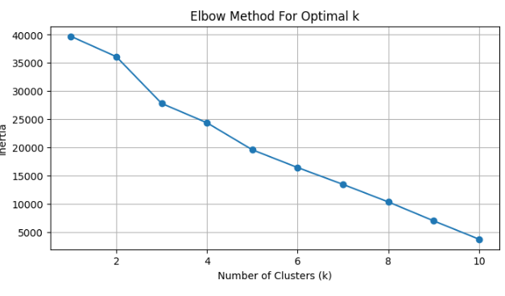
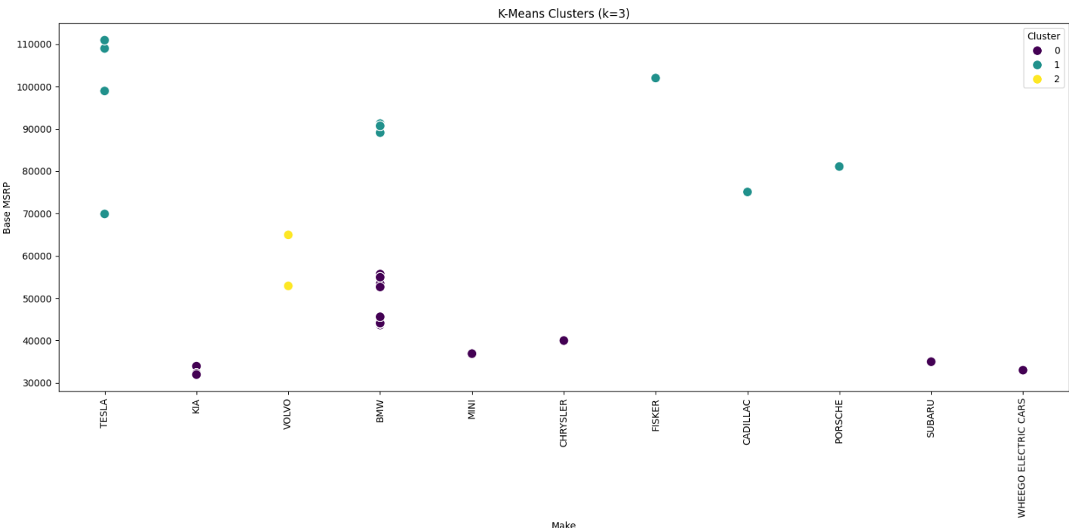
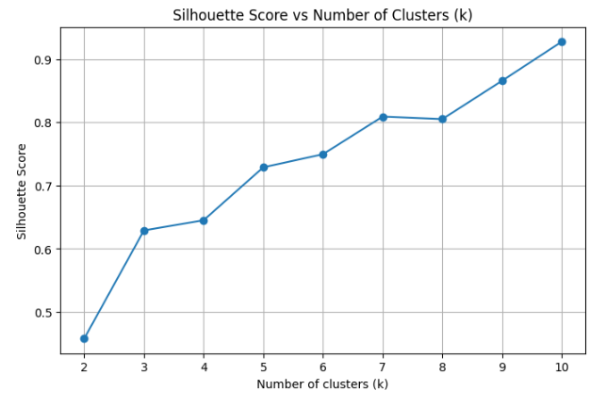
Unsupervised Machine Learning with K-Means
Notes:
In my research part for Objective 3: What is the distribution of EVs by type, price and manufacturer, I have applied Machine learning algorith - Kmeans for clustering segmantation. The model performed a clusterign segmentatation of electric vehicles based on Base MSRP, Electric Vehicle Type and Manufacturer. After the feature engineering and data preprocessing, I have used the Elbow method to define the optimal number of clusters K. I have selected for my purposes K = 3 and defined the following clusters:
Cluster 0 grouping economy to mid range vehicles such as KIA and MINI
Cluster 1 groups high-end and luxury electric vehicles such as TESLA, Porshe and Cadilac
Cluster 2 groups the mid-range to upper-range EVs,covering the gap between affordable EVs and luxury electric cars.
My performance of my ML model for k=3 is silloette score ~ 0.62, which is representing optimal performance of Kmeals model with additional room for improvements.
KMeans Model provides useful and informative view of segmentation of Electric Vehichle Dataset. Further performance tuning and improvement are recommended for more precise and actionable insights.
addCode
addText

Slide 11
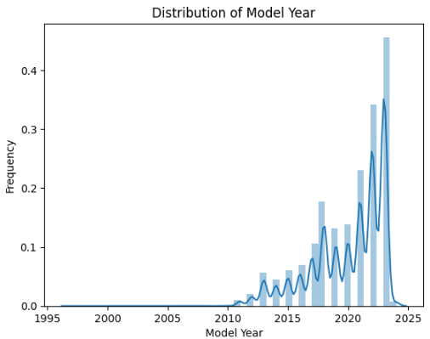
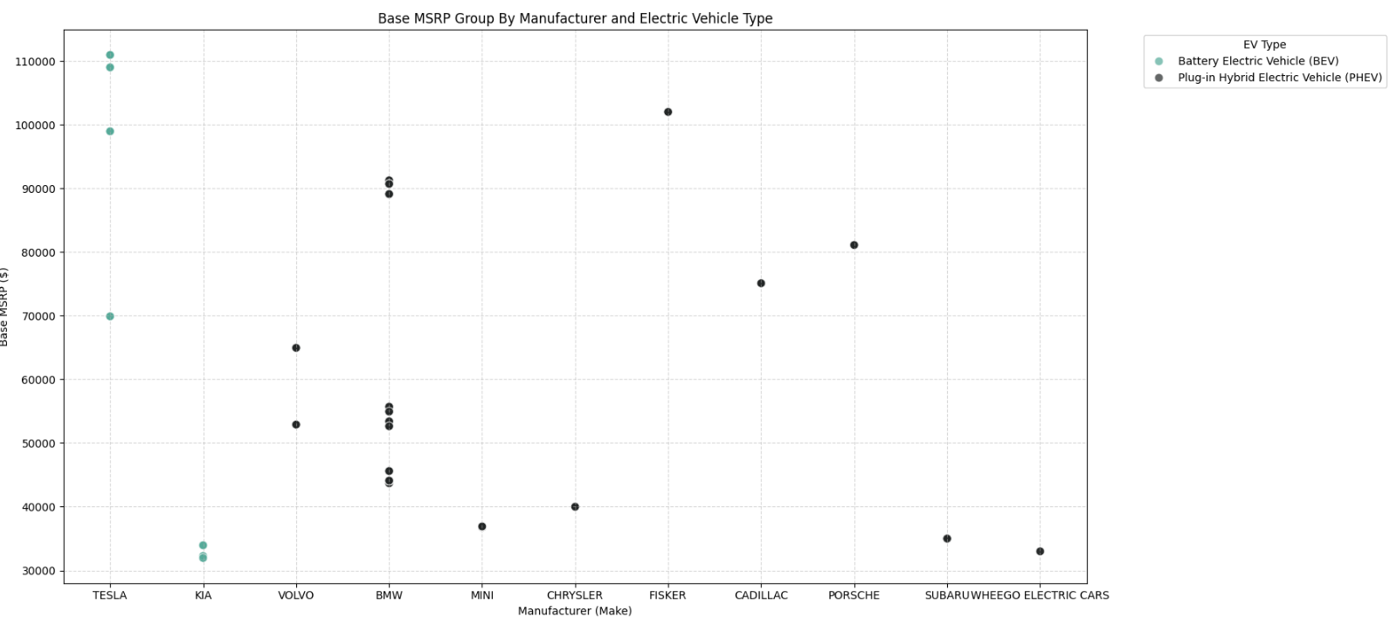
Business Insights & Conclusion
Notes:
From Distribution of Model Year -the majority of EVs are produced after 2010 with increasing uptrend from 2015. We have small Peak at 2018 and a burst boom in the last 3 years(2021–2023). From this visualization, we can see some distribution of values around 2000 and 1995, which are noticable inconsistent from the majority of data. This could be from data entry errors, invalid data as outliers or old electric/hybrid vehicles.
From our visualization, we are able to see the distribtuion of each feature of our data set. We have two different type of EVs - Baterry-in and Plug-in We have variety of manufacturers in our dataset, but we have presented the Top10. The majority of prices of EVs are around 50K−100K, which could be seen in our scatter plot as well. We have one outliers, for Porshe, which has price for over 800K$

